Slide 1

Project 3 NASA API Asteroids data
Maliha Mir
Olive McKenzie
Marta Rychel
Brad Smart

Slide 2
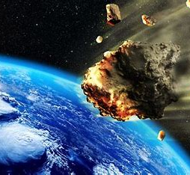
Data sources
The project focuses on the date from asteroids.
Data has been extracted from :
https://api.nasa.gov/neo/rest/v1/feed?start_date=2015-09-07&end_date=2015-09-14&api_key=DEMO_KEY

Slide 3
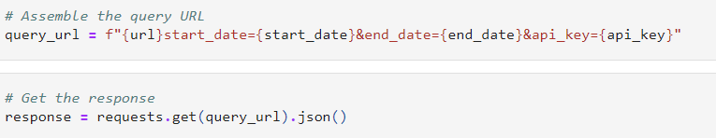
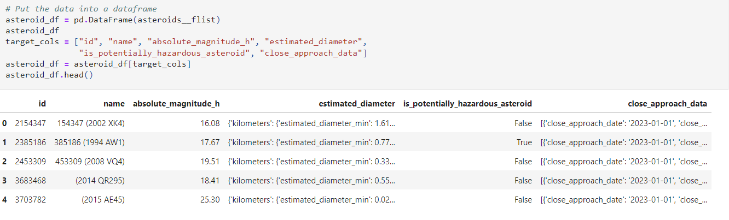
Data Collection
As mentioned above, the date are selected from NASA API and converted to Pandas DataFrame

Slide 4
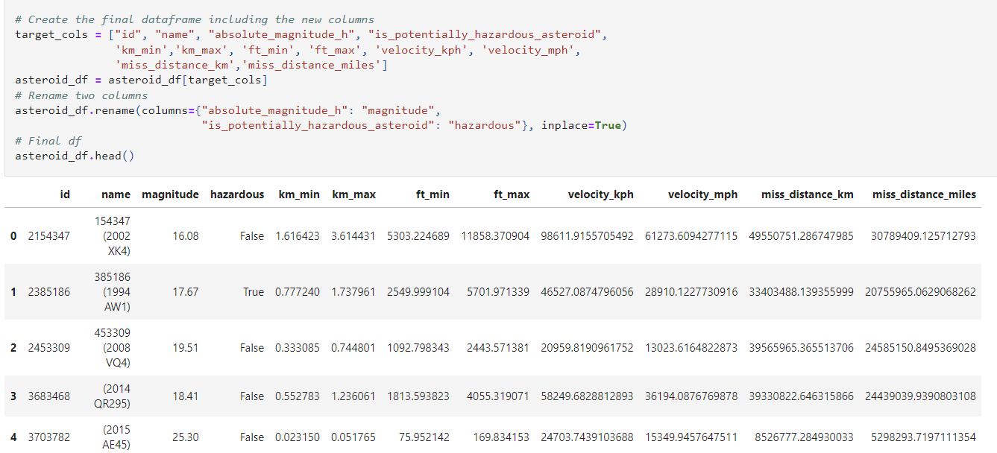
Final Dataframe

Slide 5
Database technology used

Slide 6
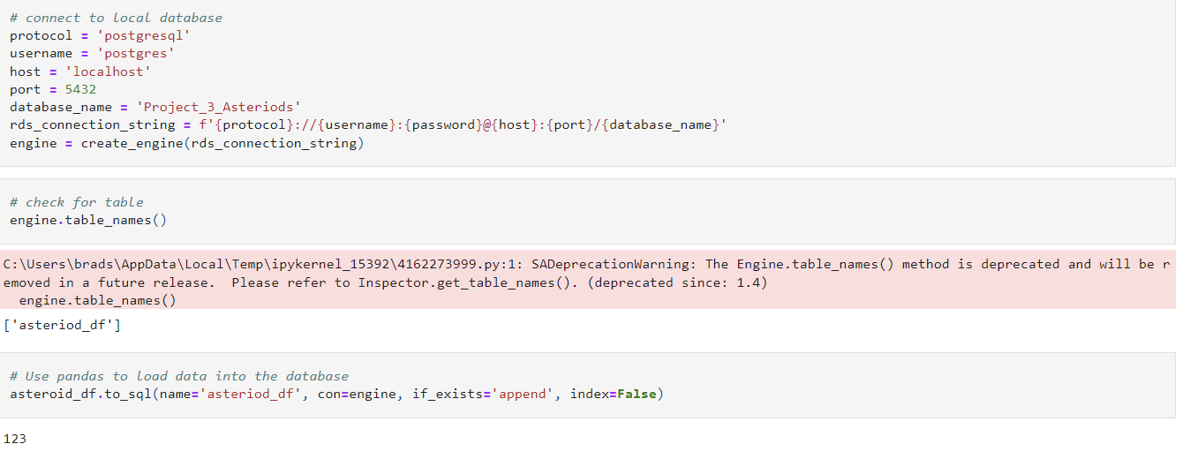
Load data on the DB
Data was loaded into a relational database for storage. ‘PGAdmin 4’ was used to create PostgreSQL tables that included the headers from the dataframe.
A localhost connection to a PostgreSQL server was created and a connection made to it. The connection was made via an engine on Jupyter Notebook that could talk to the database.

Slide 8
Visualization

Slide 9


JavaScript libraries
We used 2 libraries in our project
Plotly to create table and bar chart
Chart.js to create pie chart

Slide 10
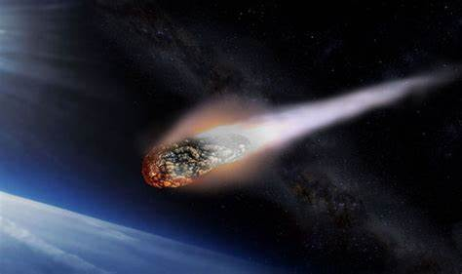
Thank you for your attention

